Slide 1
Metabolomics A Very Brief Introduction Jack Gardiner PhD., MaizeGDB
“The Genome can tell what could happen, the transcriptome can tell what appears to be happening, proteome can tell what makes it happen and metabolome can tell what has happened and what is happening”
Dettmer K. et al (2007). "Mass spectrometry-based metabolomics". Mass Spectrometry Reviews. 26(1): 51–78.

Slide 2
Metabolomics Defined
Metabolomics is the “systematic study of unique chemical fingerprints that specific cellular processes leave behind”¹.
Generally speaking, metabolomics is limited to molecules 1.5 Kda (1500 gr/mol) or less.
Metabolomics is sometimes referred to as “small molecule profiling”.
Remember that a metabolic profile represents but a single snapshot in time. The metabolome is a dynamic entity and change from second to second.
More recent efforts focus on Real Time Metabolomics which can measure hundreds of metabolites in a living cell in real time.
Davis, B (April 2005). "Growing pains for metabolomics". The Scientist. 19 (8): 25–28.

Slide 3
What Molecules are Measured in Metabolomics?
ENDOGENOUS (produced within the organism): amino acids, lipids, cofactors, nucleotides, sugars, hormones, etc.
EXOGENOUS (produced external to the organism): drugs, toxins, environmental contaminants, pesticides, herbicides, etc.

Slide 4
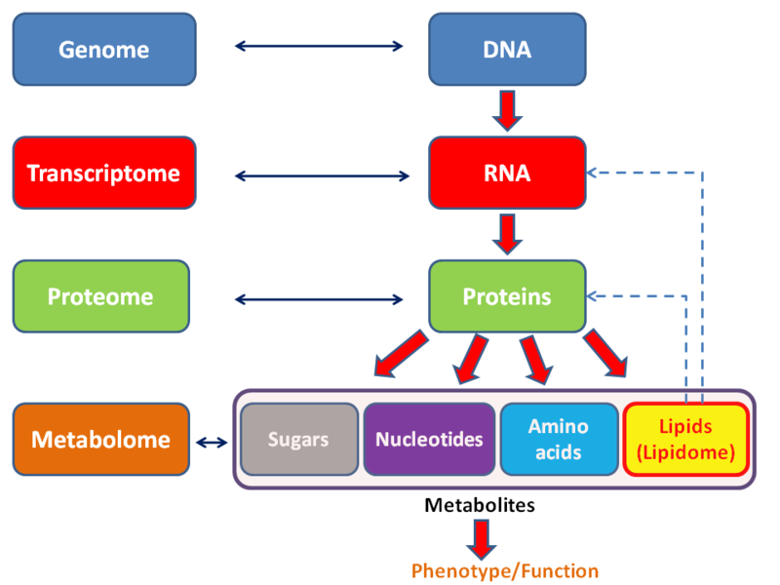
A Geneticist’s View of Metabolomics
Source:https://en.wikipedia.org/wiki/User:Lmaps

Slide 5
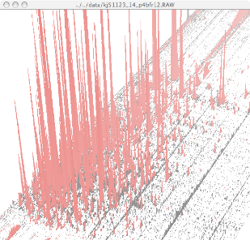
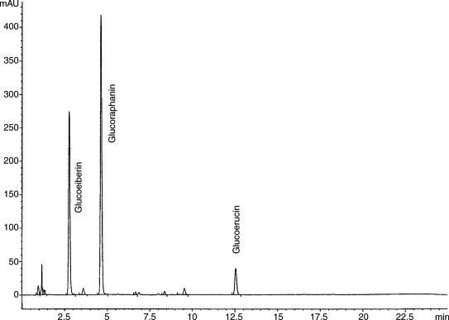
Metabolomics: Two Basic Approaches
Untargeted: Shotgun
Profiling
Targeted: Classical
Analytical Biochemistry
Provides the opportunity to see everything.
Many known, and even more unknowns!
Relative abundances of hundreds of compounds
Data analysis more difficult
Potentially a powerful phenotyping tool!
Need to have differences between biosamples for GWAS/QTL mapping
Can optimize conditions for specific metabolites.
Flavonoids, carotenoids, hormones, etc.
Can be quantified
Data analysis easier
Downside is that standards are needed.
Number of known compounds is limited
Spectra Credit: University of Wageningen

Slide 6
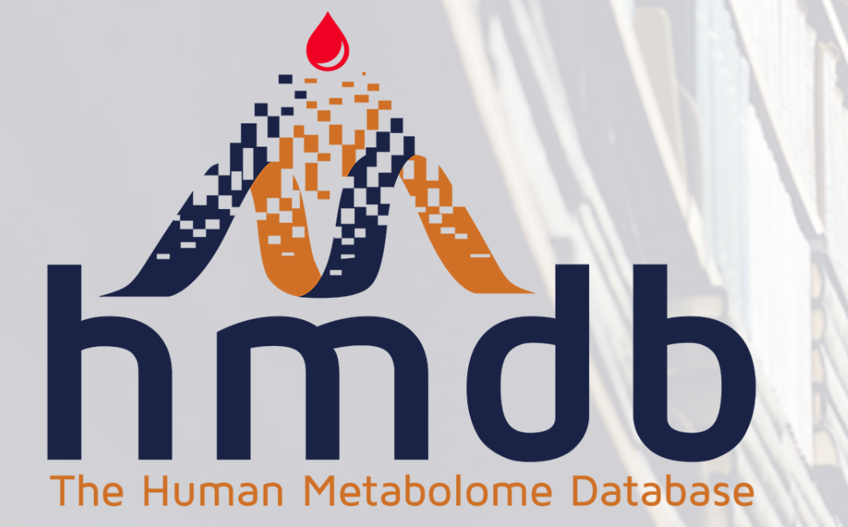
Bio Samples Vary Greatly As To How Many Metabolites They Contain
BIO Sample | Total Number of Metabolites Detected | Percent Quantified
Sweat | 91 | 86%
Cerebrospinal Fluid | 445 | 99.5%
Saliva | 1245 | 71%
Urine | 2603 | 68%
Blood | 3678 | 84%
Feces | 6810 | 26%

Slide 7
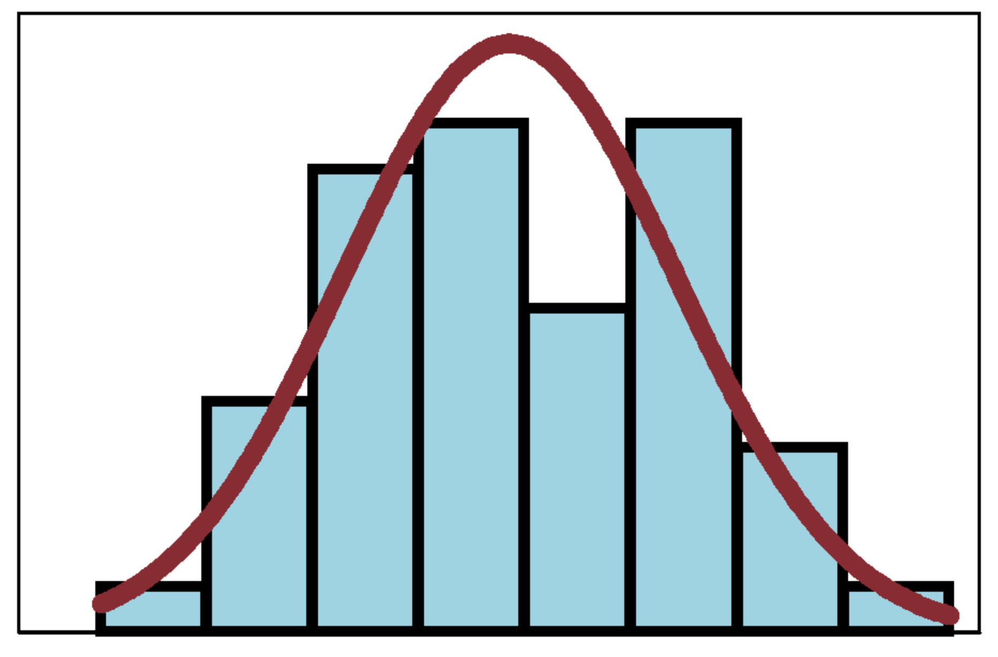
Statistical and Sampling Considerations
Experimental design is critical.
3 reps minimum, 5 reps preferred
Sample pooling is beneficial
Biological are preferred over technical reps.
In general, biological variance exceeds technical variance
Many free software packages are available.
PCA is often used in non targeted metabolic profiling
Machine learning methods can improve metabolite identification
Substantial metabolite variation is normal even in carefully collected samples.
Not all metabolites are tightly regulated. This can hamper statistical analysis.

Slide 8
Metabolomics Workflow
Sample Extraction/Collection
Separation
Detection
Data Extraction

Slide 9
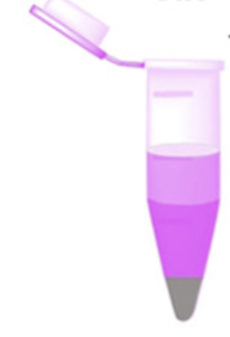
Workflow: Sample Extraction (SE)
An ideal SE should be:
selective
simple and fast
reproducible
metabolite quenching to capture metabolites in native state
Samples are generally extracted with an organic solvent and concentrated.
Internal standards are often added at the SE prep stage.
Aids downstream analysis especially for targeted approaches
A “Derivatization” step is often included.
Improves chromatography/prevents degradation
Adds additional steps

Slide 10
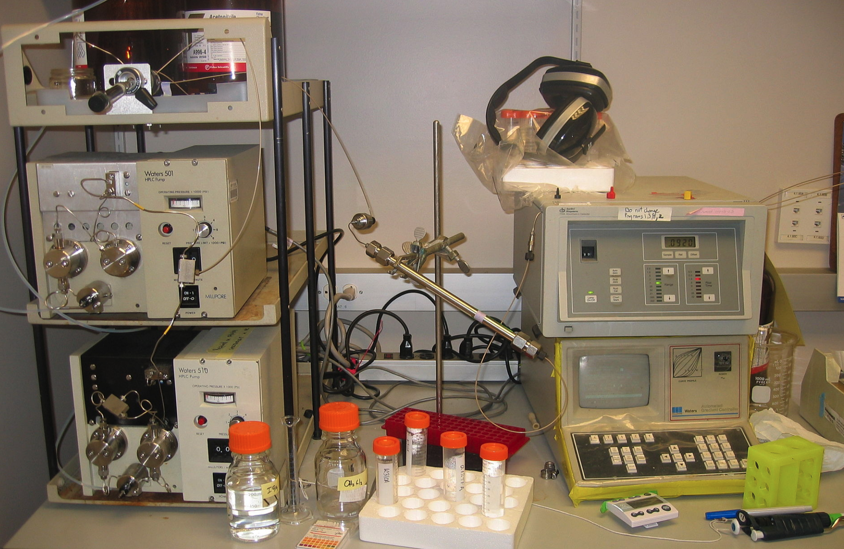
Workflow: Sample Separation
Sample separation into individual components is usually achieved by one of three methods
Gas chromatography (GC)
Ideal for small and volatile molecules
Greater sensitivity requires additional step of derivitization
High performance liquid chromatography (LC/HPLC)
Most common method, no derivitization required
Wider range of molecules can be analyzed with greater sensitivity
Capillary electrophoresis (CE)
Most appropriate for charged molecules

Slide 11
Workflow: Sample Detection
After separation, individual metabolites are usually detected by Mass Spectrometry (MS) which measures its mass to charge ratio (m/z). NMR is sometimes used but it lacks the sensitivity of MS.
Many types of MS (ESI-MS, MALDI-TOF-MS)
Common to all MS is an ionization source, mass analyzer, and a detector.
Many variations on each of these three components.
Hard vs. Soft Ionization Approaches
Soft: molecules are left intact
Hard: molecules are fragmented to produce a more detailed fingerprint.
Tandem MS uses multiple rounds of MS
High resolution fingerprints are produced and compared to standards
Useful in the identification of unknown metabolites.
METLIN Metabolite and Chemical Entity Database contains over 850,000 known standards used to assist the identification of known and unknowns.
Figure source: https://en.wikipedia.org/wiki/File:TandemMS.svg

Slide 12
Workflow: Data Extraction and Analysis
Data is for various experimental conditions is usually extracted in the form of spectra values (m/z) or metabolite features.
Lots of free software available for identifying metabolites on the basis of m/z or retention time values.
Once the data has been assembled into a treatment vs. compound table, various statistical or data reduction methods can be applied to ferret out statistically significant, meaningful biological differences. You do not need to know the identity of each compound at this point.
Principal Component Analysis (PCA) often used when identity of molecules of interest are unknown (untargeted).
Linear Models can be used but can be impacted by multicollinearity.
Univariate and multivariate statistics are often used but care must be taken to validate models and correct for multiple comparisons.
Machine Learning approaches are increasingly used to apply retention time to the prediction and identification of metabolites in a complex mixture.

Slide 13
Metabolomics/Metabolic Databases
Comprehensive Metabolomic
Metabolic Pathway DB
Compound Specific DB
Drug DB
Spectral DB
Disease and Physiology

Slide 14
Three Examples of Very Different Metabolic Databases
Human Metabolome Database (HMDB)
Human centric
Metabolites
Making data available
METLIN
Metabolite identification

Slide 15
Human Metabolome Database (HMDB)
HMDB (www.hmdb.ca/ ) contains freely available verified information on ~114,000 metabolites found in the human body
Each “Metabocard” entry contains 130 data fields with 2/3 being dedicated to Clinical/Chemical data and 1/3 to enzymatic and biochemical data
HMDB is part of a suite of four additional databases:
DrugBank (www.drugbank.ca ) information on ~2280 drugs and drug metabolites
T3DB (www.t3db.org/) information on 3670 toxins and environmental pollutants.
SMPDB (http://www.smpdb.ca ) information on pathway diagrams for 25,000 metabolic and disease pathways.
FooDB (www.foodb.ca ) information on 28,000 foods and food additives
Both simple and sophisticated searches
Text search facilitates sophisticated searches of HMDB text.
Sequence search allows BLAST searches of over 5700 DNA and protein sequences.
Advanced search allows structured searches of various combinations of subfields.
MS search allows searches of LC/MS spectra and 1D and 2D NMR spectra.

Slide 16
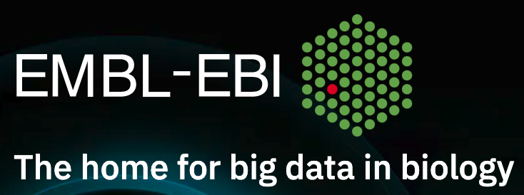
Metabolites
Metabolites is an all encompassing database focused on metabolomics experiments and the data derived from them. It is both a repository and a resource for curated metabolomics data.
Cross-species and cross technique
Includes metabolite structures, ref spectra, cellular locations, roles, and experimental metadata.
Metabolites allows users to:
Submit and browse metabolomics data (studies.
778 studies submitted to date
Can search by species, metabolite, or technique
Receive stable identifiers for publication reference.
Share data with peer reviewers or collaborators.
Download complete studies as zipped archive.
Metabolites provides online training and education resources in metabolomics.
Both basic and advanced training are offered online.

Slide 17
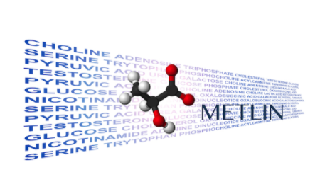
METLIN Metabolite and Chemical Entity Database
Largest repository devoted to tandem mass spectrometry. METLIN is a broad chemical and biological resource that contains data on over 850,000 standards
All standards are characterized at multiple collision energies in both positive and negative ionization modes. This results in a very detailed fingerprint.
METLIN can be searched based on tandem MS spectra, mass, chemical formula, or structure.
Very powerful at the identification of known and unknown metabolites
Cloud-based and free to public and private researchers worldwide
Developed and maintained by the Siuzdak laboratory at Scripts Research.

Slide 18
Concluding Remarks
Metabolic profiling technologies continue to evolve.
MS Detection is an active and evolving discipline.
Metabolite identification remains challenging.
Some estimates are that only 1% of molecules are identified.
Experimental design is, and will remain critical
Sample pooling and replication are critical
Collect as much metadata as possible. You won’t regret this.
Consult a statistician BEFORE in the experiment planning stages
Phenotyping and metabolic profiling are a powerful combination
Variation is needed. Diversity panels (GWAS) are preferred over bi-parental populations (QTLs)
Untargeted approaches are challenging but will yield the most information.
Databases play a key role now and in the future
Room for everyone.

Slide 19
Questions?

